Slide 1
Architectural Patterns-3 Adaptable systems
UNIT 6

Slide 2
Agenda
Introduction
Adaptable Systems
Microkernel
Reflection

Slide 3
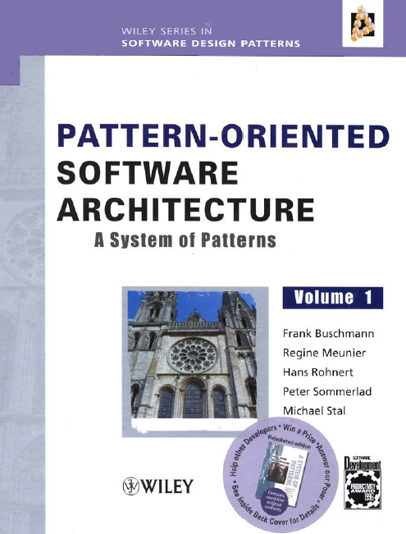
Reference

